Slide 1

4.09

Slide 2

Telehealth Simplified
4.09
May 16th, 2021
Remote Healthcare Solutions for Elderly Patients: Reducing Barriers to Telehealth

Slide 3

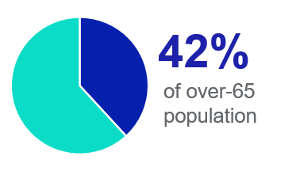
Target Persona: Mike
4.09
There are 22 million people like Mike in the U.S.

Slide 4
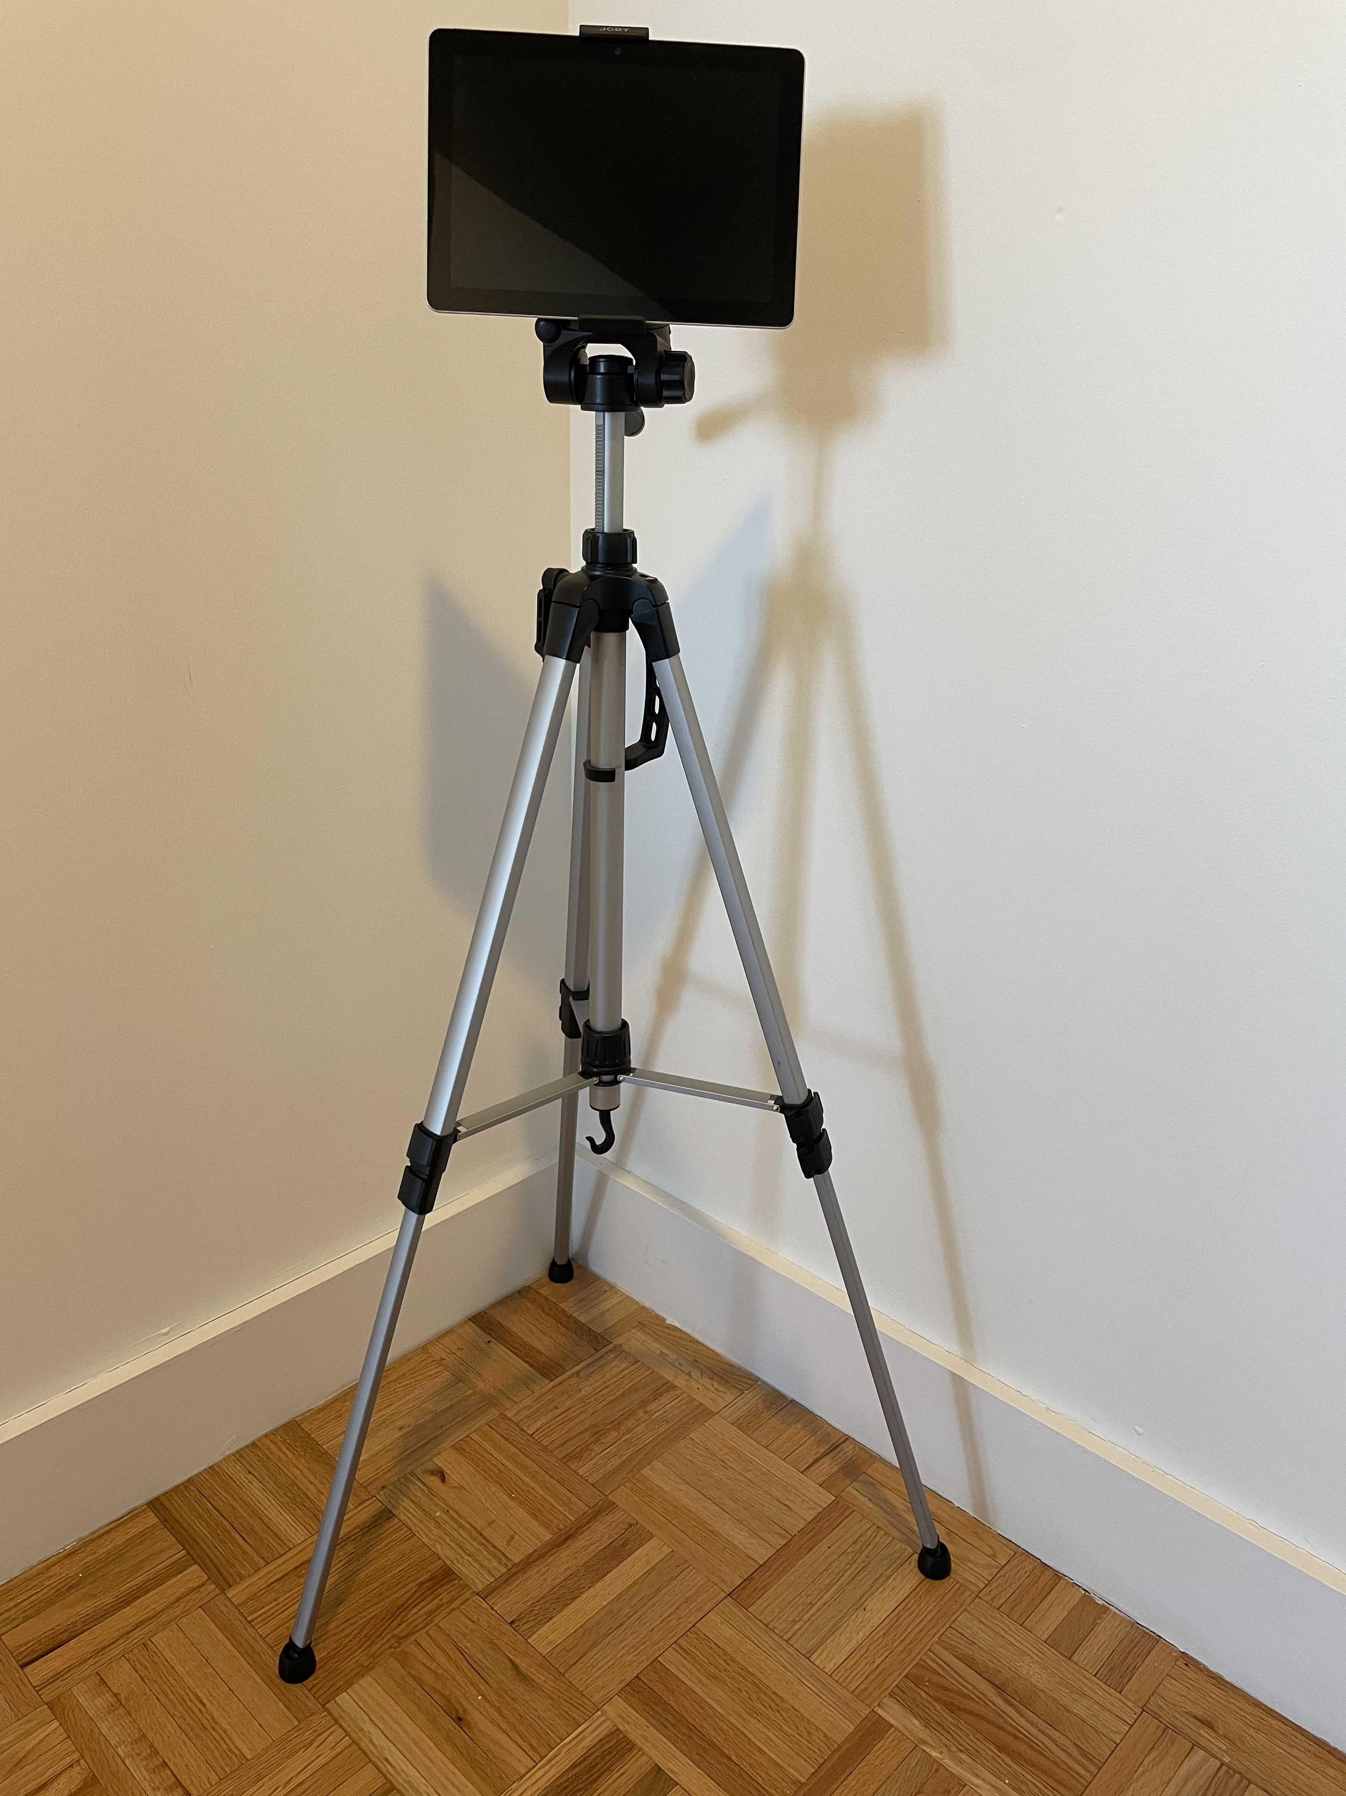
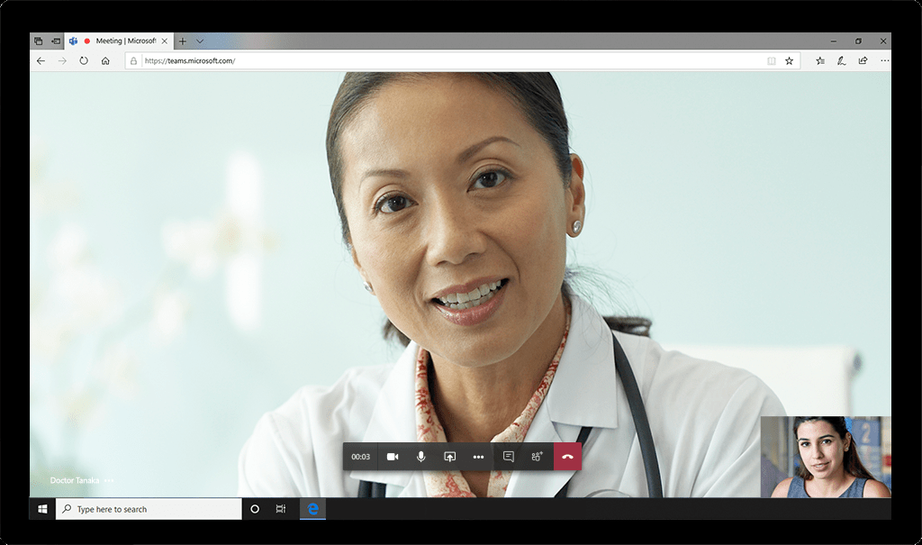
Our Solution: Telehealth Simplified
4.09
Single-purpose tablet
Direct-to-provider link
Cellular data (or existing WiFi)
Reduces complexity for elderly patients

Slide 5
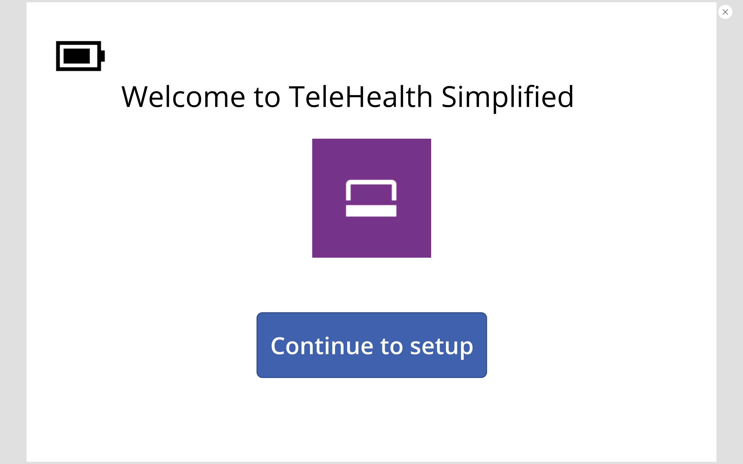
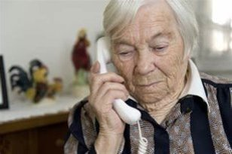
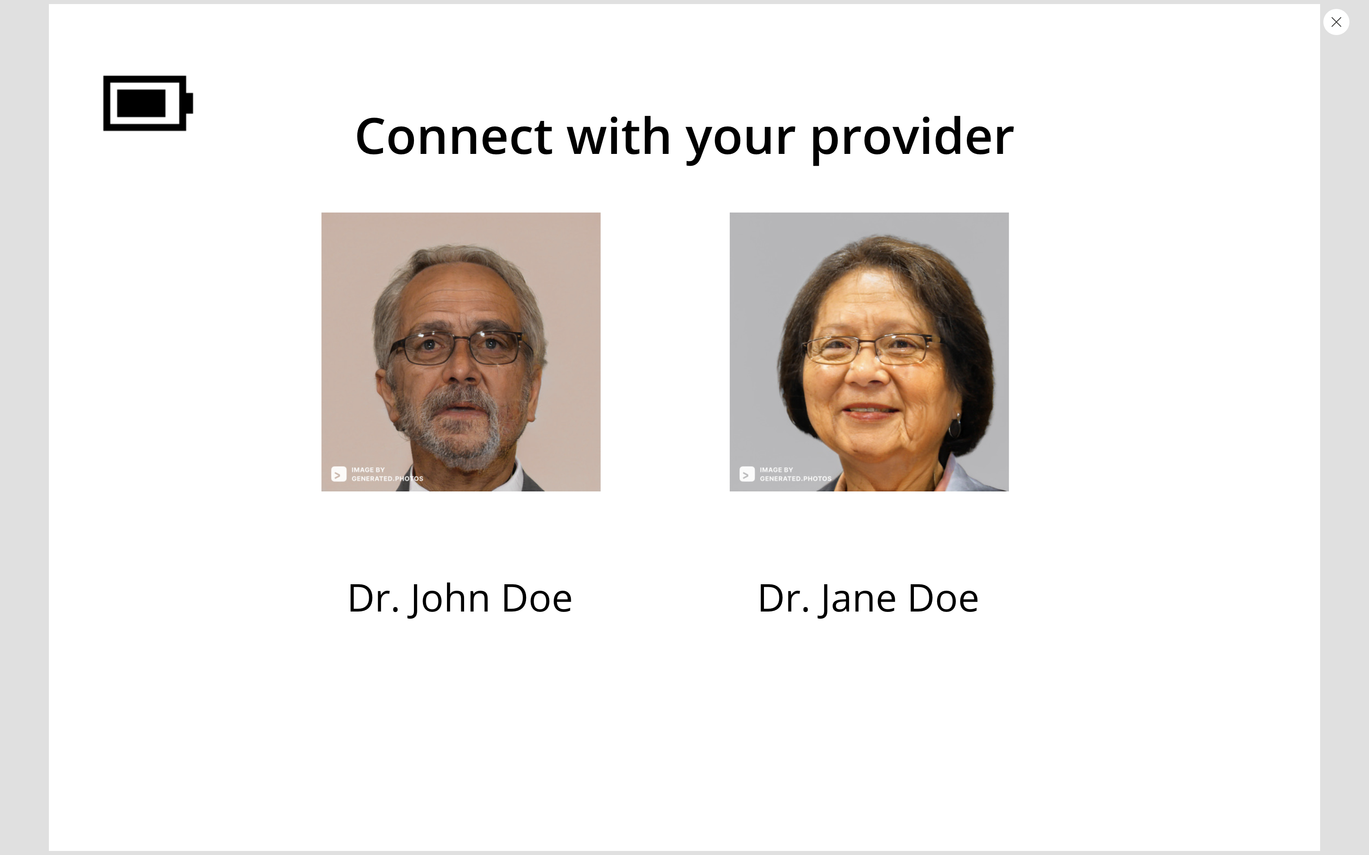





How does it work?
4.09
Product Setup
1. Schedule
2. Connect
5

Slide 6
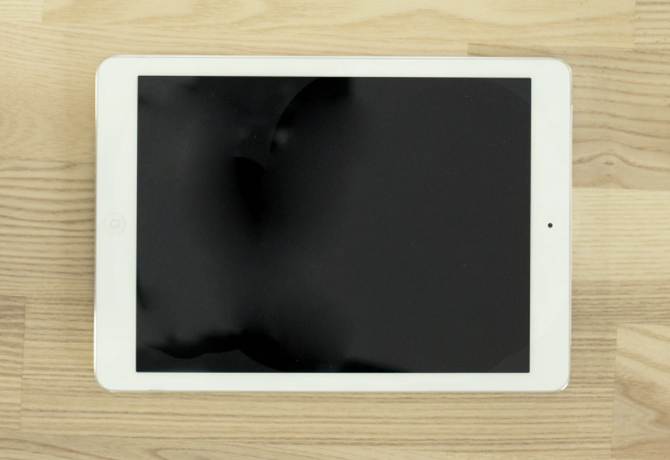



Will it scale?
4.09
Telehealth Simplified is not tied to a single institution. It will work with popular telehealth solutions used by various healthcare systems.
Success requires integration of the following:
Hardware Provider
Existing telehealth solutions
Telecommunication
Product Marketing
Notes:
When devising a solution, you should always think about your target population and give it some thought as to how the solution can be scaled and implemented everywhere not just at your institution( this can happen later, of course, but be prepared to answer the question).
Are there other case uses for your solution?
What do you need to be successful?
Who else needs to be involved to implement your solution?

Slide 7
Summary
4.09
Covid-19 rapidly accelerated telehealth utilization for healthcare delivery.
By implementing our Telehealth Simplified tool, remote access to healthcare can be extended to vulnerable, elderly populations that would otherwise have limited options for receiving care.
Name | Role | Contact
Lisa Linares | Nurse Practitioner | linareslm@gmail.com
Dolu Obatusin | Product Developer | dolu.obatusin@gmail.com
Kalen Scott | Undergraduate Engineer | kalen.j.scott@vanderbilt.edu
Thomas Peavey | Instructional Designer | trpeavey@uw.edu
Sumit Bhuttan | Cloud Solution Architect | sumit.bhuttan@microsoft.com
Rodda Ouma | Analytics Consultant | rodda05@gmail.com
Cecilia Venzon | Clinical Practice Specialist | cecev8@gmail.com
Rochelle Sandell | RN/Attorney | rochelle.sandell@outlook.com

Slide 8
Thank you & Questions?
4.09

Slide 9
Appendix
4.09
Report: 22 Million U.S. Seniors Lack Broadband Internet Access | Business Wire
Technology struggles for seniors pose challenges to medical access in Covid-19 times - CNN
Keep families closer with GrandPad

Slide 10
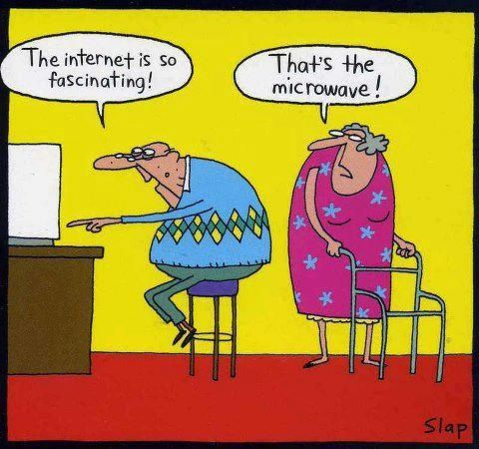
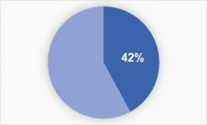
Background (merge w/ persona)
4.09
Covid pushed doctor's visits to telehealth; led to an increased need for telehealth:
Telehealth visits increased from 4% to 26% in ages 50-80
Affected a vulnerable elderly patient population that does not have access to internet and/or lacks tech skills to navigate complex solutions associated with current access to telehealth
22 million American seniors do not have broadband access at home, ~42% of over-65 population
Landmark's attempt at delivering remote care revealed that <25% had appropriate technology and knew how to use it
Poses challenges/risks to patient in need of care

Slide 11
Implementation Cost
4.09
Problem Articulation
Current Solutions
Solution (MVP)
Implementation Cost
Scalability
The Team & Close
Questions
Implementation | Who bears the cost | Cost
Hardware | Insurance | $150
Shipping Logistics | User | $20
Cellular Cost for Data plan | Insurance | $50
Technical Support | Insurance | $10
RN Visit | Insurance | $40
Three groups used to penetrate the market
Telecommunication: Existing Phone Programs (ATT, T-Mobile) dependent on geographical area
Healthcare providers: Medicare
Hardware Companies: Amazon Care/Fire Tablet; Apple

Slide 12
Scalability
4.09
Our solution is not tied to a single institution. It will work with popular telehealth solutions used by various healthcare provider.
For us to be successful we will need following -
Support from hardware company to build tablets to our specs.
Help with product marketing and promotion
Integration with Microsoft Teams or Epic solution will be required to integrate with systems used by providers to receive calls.
Notes:
When devising a solution, you should always think about your target population and give it some thought as to how the solution can be scaled and implemented everywhere not just at your institution( this can happen later, of course, but be prepared to answer the question).
Are there other case uses for your solution?
What do you need to be successful?
Who else needs to be involved to implement your solution?

Slide 13
Currently Available Solutions
4.09
Telehealth options exist; nothing specific to mitigate challenges to target population
Tech knowledge
Hardware access/affordability
Internet access
GrandPad- tablet loaded with senior-friendly apps designed for adults 75 and older
Difference- multi-purpose tablet/app; must have access to wifi; 8-in screen, subscription service

Slide 14
Compare/Contrast Example
Subhead
Subhead
Your body copy goes here. Body copy goes here. Body copy goes here. Body copy goes here.
Your body copy goes here. Body copy goes here. Body copy goes here. Body copy goes here.
1 in 5
3 in 5
Describe your statistic here. This is where the text goes, in Arial 15pt font.
Describe your statistic here. This is where the text goes, in Arial15pt font.
22%
Subhead
Subhead
42%
Your content relating to the pie chart can go here.
Your first bullet point can go here.
This is where your second bullet point will go.
Your first bullet point can go here.
This is where your second bullet point will go.
of over-65 population

Slide 15
EXAMPLE 2 – Our Solution vs. The Competition
Benefits | Our Solution | Competitor 1 | Competitor 2 | Competitor 3 | Competitor 4
Intuitive Design
Cost
Performance
Quality
Complexity
Overall Assessment | 5 | 3 | 2 | 2 | 1

Slide 16
4.09

Slide 17
EXAMPLE 1 – Our Solution vs. The Competition
Benefits | Our Solution | Competitor 1 | Competitor 2 | Competitor 3 | Competitor 4
Intuitive to Use | X
Cost to Use | Free | $X Subscription
Platform | Microsoft | Zoom
Users | Patients/Families/Clinicians | Clinicians only

Slide 18
Good Luck & Good Pitching!
– From NurseHack4Health Organizers

Slide 19
General Data
4.09
Problem Articulation
Current Available Solutions
Your Solution (MVP)
Implementation Cost
Scalability
The Team & Close
Questions
HOW BIG IS THIS PROBLEM (Scope)? HOW MANY PEOPLE DOES IT AFFECT?
Data helps here if you can find the right information.
22 million American seniors do not have broadband access at home, ~42% of over-65 population...
When SCAN Health Plan, a Medicare Advantage plan with 215,000 members in California, surveyed its most vulnerable members after the pandemic hit, it discovered that about one-third did not have access to technology needed for a telehealth appointment.
Landmark tried to deliver care remotely. It soon discovered that fewer than 25% of patients had appropriate technology and knew how to use it.

Slide 20
Additional charts, process, timeline templates
Use if helpful

Slide 21
Slide Title in Arial Bold, 30 pt. Black
Subtitle in Arial Regular, 20 pt.
Use this template for two columns of text, two images, or to pair text with a cropped image. If there is only one chunk of copy, consider getting rid of the bullets.

Slide 22
Slide Title in Arial Bold, 30 pt. Black
Subtitle in Arial Regular, 20 pt.
In some cases, the image will sit to the left of the text.
Make sure whichever you choose, it is consistent throughout your presentation.

Slide 23
Slide Title in Arial Bold, 30 pt. Black
Subtitle in Arial Regular, 20 pt.
Bulleted copy spans two columns, to the right of a single-column image.
In this scenario, image should usually be on the left.

Slide 24
Slide Title in Arial Bold, 30 pt. Black
Subtitle in Arial Regular, 20 pt.
Three columns of text
or text with imagery
or just images

Slide 25
Slide Title in Arial Bold, 30 pt. Black
Subtitle in Arial Regular, 20 pt.
Three columns of text
or text with imagery
or just images

Slide 26
“Use this template to add extra emphasis to a quote, fact or statistic.”
– Attribution

Slide 27
“Use this template to add extra emphasis to a quote, fact or statistic.”
– Attribution

Slide 28
“Use this template to add extra emphasis to a quote, fact or statistic.”
– Attribution

Slide 29
Bar Chart Example
Extending past 6 colors
Manually select colors from palette to complete the chart.
When using bar charts, retain a minimum distance of 50% between data points.

Slide 30
Compare/Contrast Example
Subhead
Subhead
Your body copy goes here. Body copy goes here. Body copy goes here. Body copy goes here.
Your body copy goes here. Body copy goes here. Body copy goes here. Body copy goes here.
1 in 5
3 in 5
Describe your statistic here. This is where the text goes, in Arial 15pt font.
Describe your statistic here. This is where the text goes, in Arial15pt font.
22%
Subhead
Subhead
42%
Your content relating to the pie chart can go here.
Your first bullet point can go here.
This is where your second bullet point will go.
Your first bullet point can go here.
This is where your second bullet point will go.
of over-65 population

Slide 31
Stacked Column Example
Align elements to the grid and enhance the size of key.
% to Sales
2006 25.7%
2007 26.0%
$15.9B
$14.6B
$6.0
$5.7
$6.9
$7.6
MD&D
Consumer
Pharmaceuticals
$2.0
$2.3

Slide 32
Compare/Contrast Example
Subhead
Subhead
Your body copy goes here. Body copy goes here. Body copy goes here. Body copy goes here.
Your body copy goes here. Body copy goes here. Body copy goes here. Body copy goes here.
1 in 5
3 in 5
Describe your statistic here. This is where the text goes, in Arial 15pt font.
Describe your statistic here. This is where the text goes, in Arial15pt font.
22%
Subhead
Subhead
42%
Your content relating to the pie chart can go here.
Your first bullet point can go here.
This is where your second bullet point will go.
Your first bullet point can go here.
This is where your second bullet point will go.
of over-65 population

Slide 33
4 Column Organization
Subhead1
Subhead 2
Subhead 3
Subhead 4
Put your body copy for subhead one here. You can divide into paragraphs, if needed. This is where the body copy goes. This is where the body copy goes. This is where the body copy goes.
Put your body copy for subhead one here. You can divide into paragraphs, if needed.
Put your body copy for subhead one here. You can divide into paragraphs, if needed. This is where the body copy goes. This is where the body copy goes. This is where the body copy goes. This is where the body copy goes. This is where the body copy goes. This is where the body copy goes.
Put your body copy for subhead one here. You can divide into paragraphs, if needed. This is where the body copy goes. This is where the body copy goes.

Slide 34
Pyramid Example
Subtitle in Arial Regular, 20 pt.
Manually select colors from palette to complete the chart. Include any explanatory information here.
Level 5
Your Content Here
Level 4
Your Content Here
Level 3
Your Content Here
Level 2
Your Content Here
Level 1
Your Content Here

Slide 35

Name Lastname
Title
Write a short biography here…

Slide 36
Timeline
 | August |  |  |  | September |  |  |  | October
 | Week 1 | Week 2 | Week 3 | Week 4 | Week 1 | Week 2 | Week 3 | Week 4 | Week 1 | Week 2 | Week 3 | Week 4
Task Title 1
Task Title 2 |  | Milestone
Task Title 3
Task Title 4 |  |  |  |  | Milestone
Task Title 5
Task Title 6
Task Title 7 |  |  |  |  |  |  | Milestone
Task Title 8 |  |  |  |  |  |  |  |  |  |  | Milestone

Slide 37
Timeline Overview
Phase 1 Description
Phase 2 Description
Phase 3 Description
Phase 4 Description
Deliverable 1 Additional info
Deliverable 2 Additional info
Deliverable 3 Additional info
Deliverable 4 Additional info

Slide 38
Venn Diagram
Topic 1
Topic 3
Topic 2
Text goes here
Text goes here
Text goes here
Text goes here
Text goes here
Text goes here
Text goes here
Text goes here
Text goes here

Slide 39


Organizational Chart
Name Lastname Title Description here…
Name Lastname Title Description here…
Name Lastname Title Description here…
Name Lastname Title Description here…
Name Lastname Title Description here…
Name Lastname Title Description here…
Name Lastname Title Description here…
Name Lastname Title Description here…
Name Lastname Title Description here…
Name Lastname Title Description here…
Name Lastname Title Description here…
Name Lastname Title Description here…
Name Lastname Title Description here…

Slide 40
Table Example A
Use solid colors headers and row color variations to separate information. Change table colors using the Table Design tab.
TOTAL COMPANY | 2010 | 2009 | % Change
 |  |  | TOTAL | OPS
Sales | $61.6B | $61.9B | (0.5%) | (1.3%)
Adjusted Earnings* | $13.3B | $12.9B | 2.9%
Adjusted EPS* | $4.76 | $4.63 | 2.8%
Free Cash Flow** | $14.0B | $14.2B

Slide 41
Product Demo Image or GIF
1
2

Slide 42
Table Example B
Use solid colors headers and row color variations to separate information. Change table colors using the Table Design tab.
TOTAL COMPANY | 2010 | 2009 | % Change
 |  |  | TOTAL | OPS
Sales | $61.6B | $61.9B | (0.5%) | (1.3%)
Adjusted Earnings* | $13.3B | $12.9B | 2.9%
Adjusted EPS* | $4.76 | $4.63 | 2.8%
Free Cash Flow** | $14.0B | $14.2B

